Slide 1
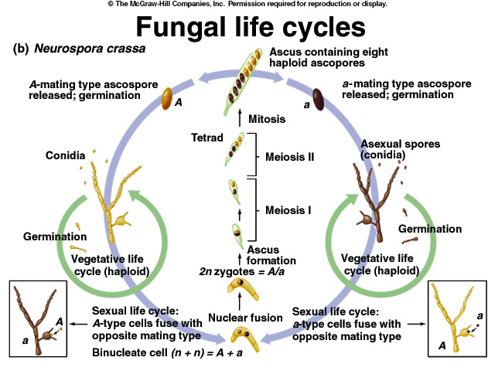

Slide 2
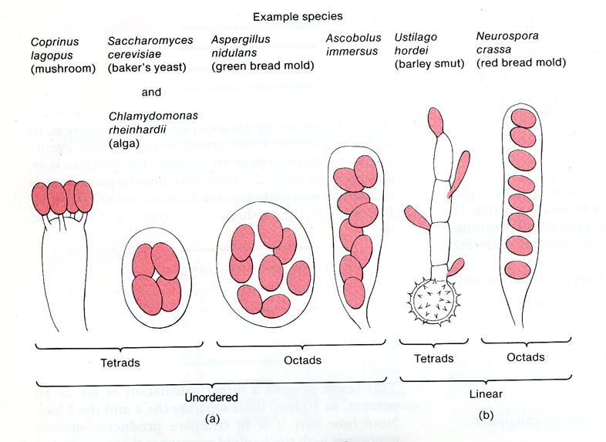

Slide 3
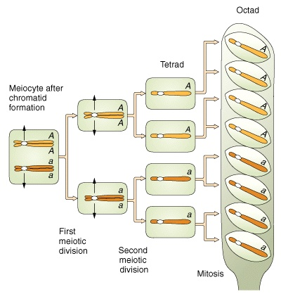
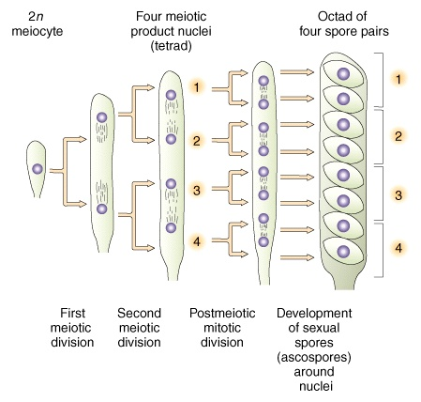

Slide 4
Ordered (linear) tetrad
Ordered tetrad analysis can be used to determine the map distance between a gene and the centromere (a process sometimes called mapping the centromere).
Ordered tetrad analysis can be used to determine when crossing over occurred based on the expected patterns of first-division and second-division segregations.

Slide 5
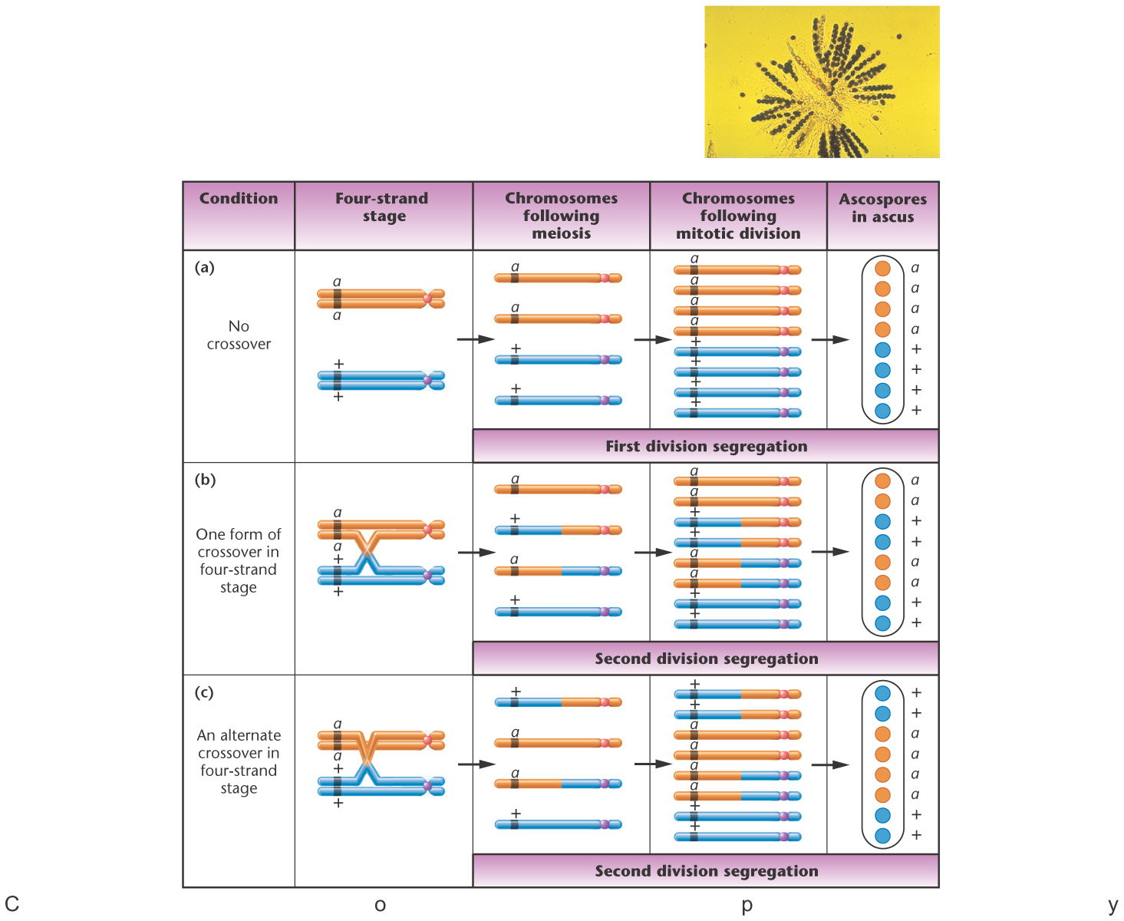
Notes:
Figure 5-20 Three ways in which different ascospore patterns can be generated in Neurospora. Analysis of these patterns can serve as the basis of gene-to-centromere mapping. The photograph shows a variety of ascospore arrangements within Neurospora asci.

Slide 6
Ordered Tetrad
Cross A x a
M_{I}
M_{II}
Asci
A a A a A a
A a A a A a
A a a A a A
A a a A a A
a A A a a A
a A A a a A
a A a A A a
a A a A A a
126 132 9 11 10 12
Number
Total = 300

Slide 7
Ordered Tetrad
Cross A x a
M_{I}
M_{II}
Asci
A a A a A a
A a A a A a
A a a A a A
A a a A a A
a A A a a A
a A A a a A
a A a A A a
a A a A A a
126 132 9 11 10 12
Number
Total = 300
M_{II} pattern frequency is (9+11+10+12)/300=42/300
Tricky here: Only half of M_{II} products of meiosis are recombinant.

Slide 8
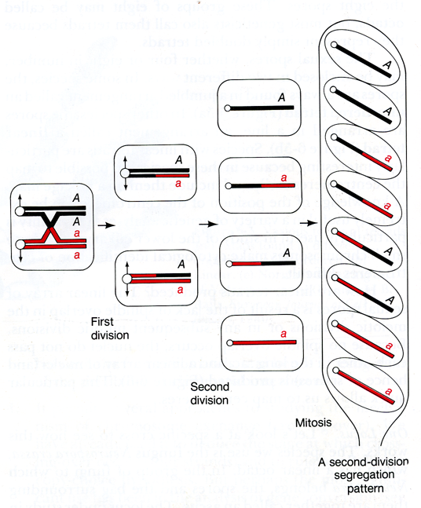
Only half are recombinants
4 products of meiosis
Parental
Recombinant
Recombinants
Recombinant
Parental

Slide 9
Ordered Tetrad
Cross A x a
M_{I}
M_{II}
Asci
A a A a A a
A a A a A a
A a a A a A
A a a A a A
a A A a a A
a A A a a A
a A a A A a
a A a A A a
126 132 9 11 10 12
Number
Total = 300
1/2 x M_{II}
The genetic distance from centromere is:
Total
d = 1/2 x (9+11+10+12)/300 = 0.07 or 7 m.u.

Slide 10
Tetrad Analysis – two loci
Cross: + a x b +
Asci
+ a + + + + + a + a + + + +
+ a + + + a b a b + b a b a
b + b a b + + + + a + + + a
b + b a b a b + b + b a b +
808 1 90 5 90 1 5
Number
Total = 1000
We are interested in the genetic distance between a and b

Slide 11
Tetrad Analysis
parental ditypes (PD), in which there are only two genotypes (hence ditype) with respect to the marker loci and both are parental.
nonparental ditypes (NPD), in which there are only two genotypes, and both are nonparental or recombinant.
tetratype(T) in which there are four genotypes -two parental and two recombinant.

Slide 12
Tetrad Analysis
Cross: + a x b +
Asci
PD
NPD
T
T
PD
NPD
T
+ a + + + + + a + a + + + +
+ a + + + a b a b + b a b a
b + b a b + + + + a + + + a
b + b a b a b + b + b a b +
808 1 90 5 90 1 5
Number
Total = 1000

Slide 13
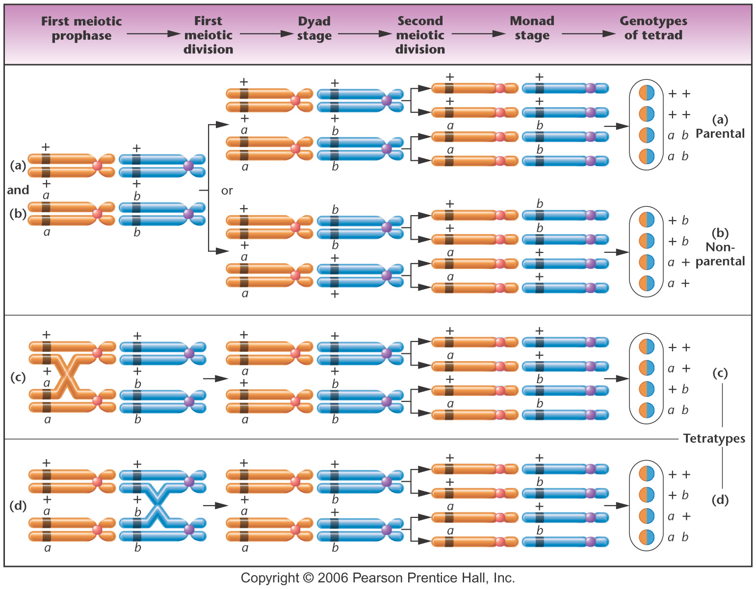
Figure 5-21 Copyright © 2006 Pearson Prentice Hall, Inc.
Notes:
Figure 5-21 The origin of various genotypes found in tetrads in Chlamydomonas when two genes located on separate chromosomes are considered.

Slide 14
Linkage?
If the number of PD = NPD, the loci are unlinked.
If the number of NPD is much less than PD, the loci are linked.

Slide 15
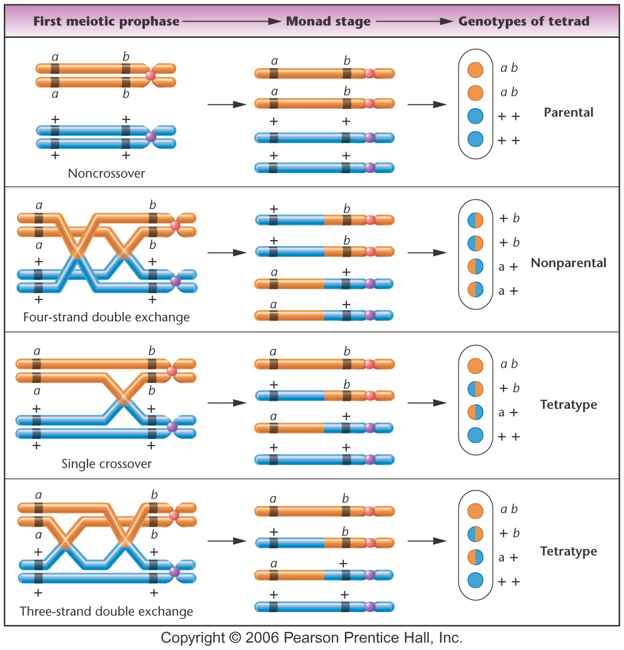
Notes:
Figure 5-22 The various types of exchanges leading to the genotypes found in tetrads in Chlamydomonas when two genes located on the same chromosome are considered.

Slide 16
Tetrad Analysis
Cross: + a x b +
Asci
PD
NPD
T
T
PD
NPD
T
+ a + + + + + a + a + + + +
+ a + + + a b a b + b a b a
b + b a b + + + + a + + + a
b + b a b a b + b + b a b +
808 1 90 5 90 1 5
Number
Total = 1000
NPD + 1/2 x T
2 + 1/2 x (100)
RF =
=
= 0.052 or 5.2 m.u.
Total asci
1000

Slide 17
Gene Conversion
A meiotic process of directed change in which one allele directs the conversion of a partner allele to its own form.

Slide 18
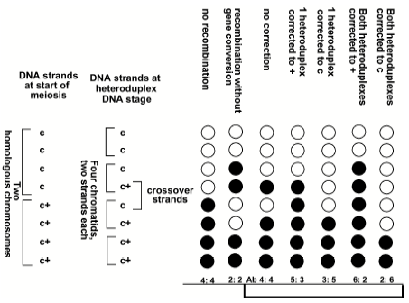
Gene conversion in Neurospora

Slide 19
Heteroduplex
A DNA double helix formed by annealing single strands
From different sources.
ADE2(+)
ade2 mutation
heteroduplex
G
C
A
T
G
T
Mitosis w/o repair
G
C
A
T
Heteroduplex DNA leads to sectored colonies

Slide 20
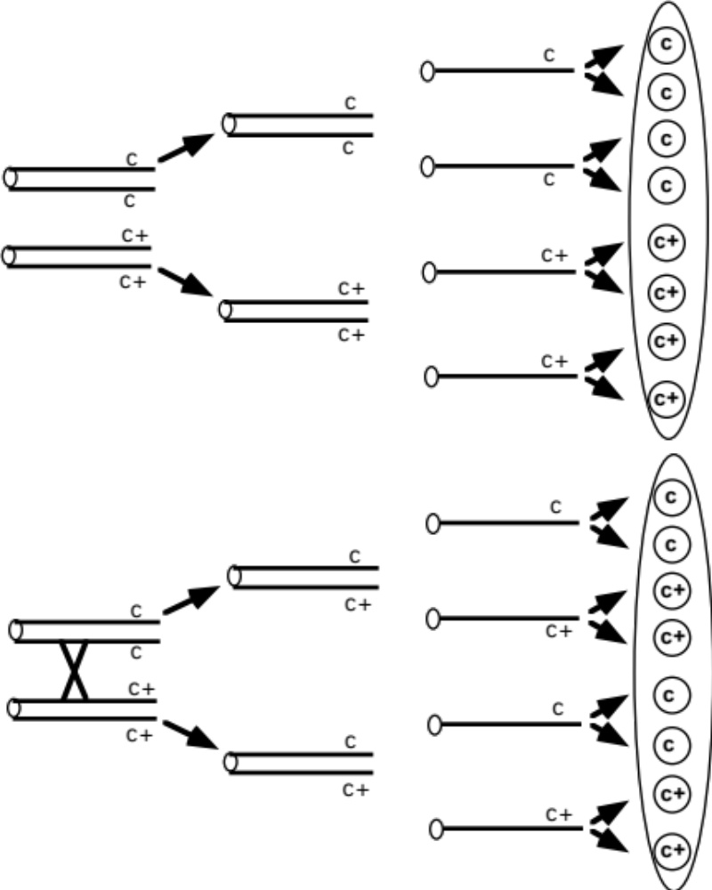
Recombination occurring far away from the c gene in Neurospora
Leads to a 2: 2: 2: 2 ratio of spores

Slide 21
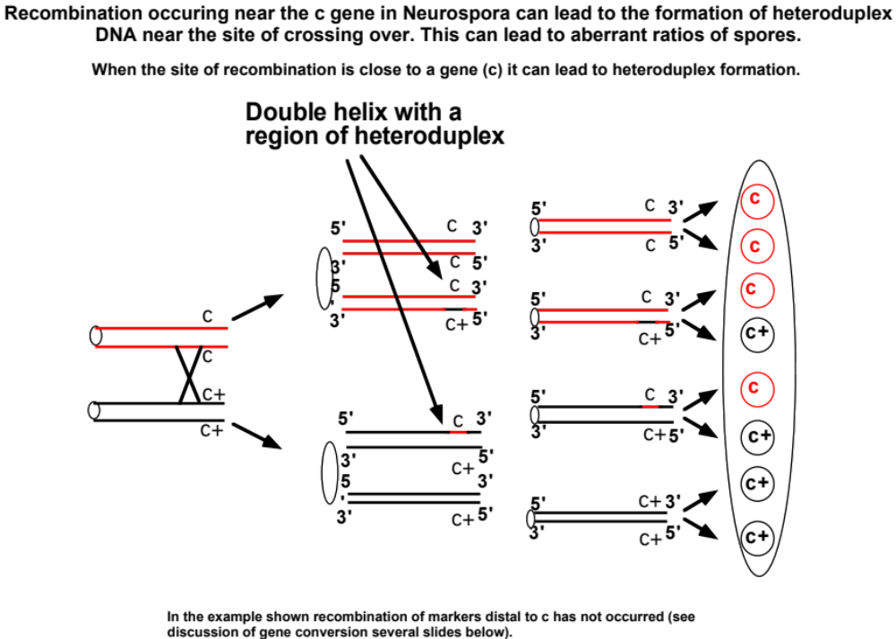

Slide 22
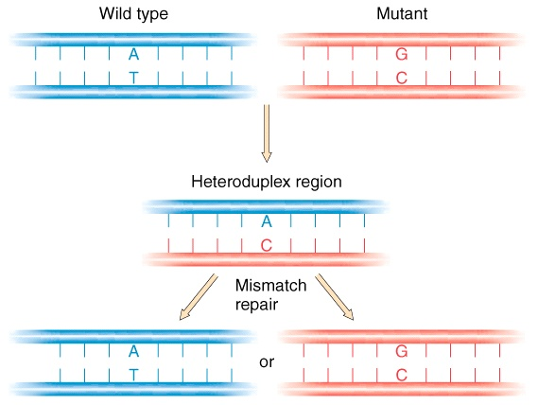
Gene conversion in a heteroduplex
1. Gene conversion results from the repair of heteroduplex DNA by the mismatch repair system. Repair
can occur in either direction.
2. Gene conversion can result in the loss of allelic information near the site of crossover.
3. 50% of gene conversions are associated with crossing over.
4. But crossing over is only rarely associated with gene conversion since the amount of heteroduplex DNA
Is typically small.
No repair. The duplexes
segregate following DNA
replication reproducing
the two original alleles

Slide 23
Repairing c to
c⁺ will give a 5:3

Slide 24
Repairing both c’s
to c⁺ will give a 6:2

Slide 25
Robin Holliday in 1964 was the first person to propose a coherent model for recombination.
The model was based on genetic data from fungi and phage.
Gene conversion must allow for heteroduplex DNA.
Heteroduplex DNA must be just as common on one strand as on the other.
Must account for 50% recombination associated with gene conversion.

Slide 26
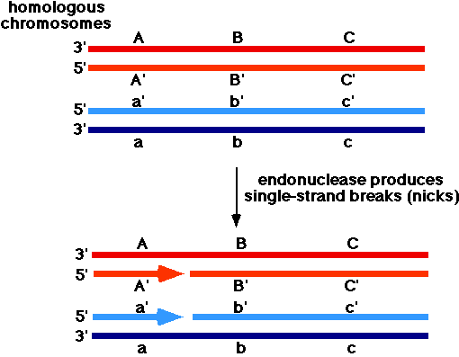
I got these diagrams from http://www.blc.arizona.edu/marty/411/Modules/HomolRecom.html

Slide 27
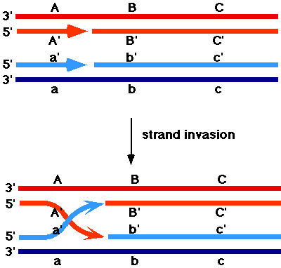

Slide 28
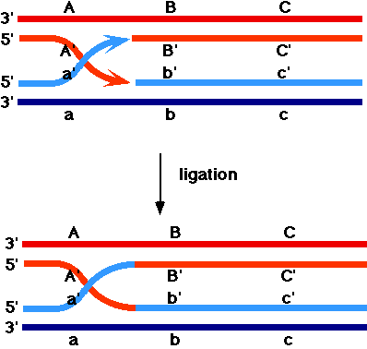

Slide 29
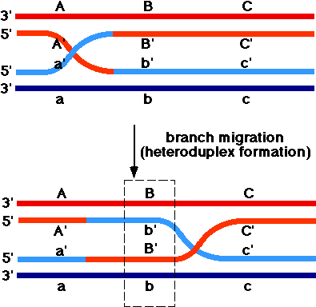

Slide 30
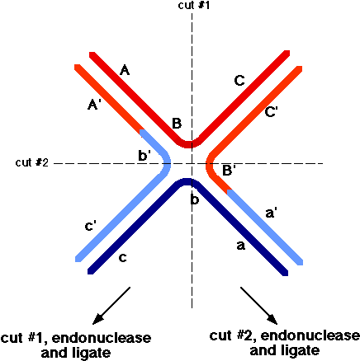
Holliday structure

Slide 31
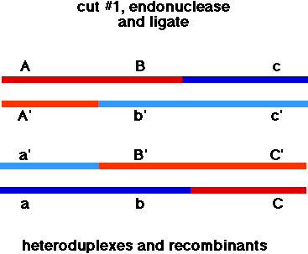
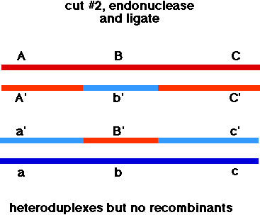
Because the Holliday junction is symmetric, predicts equivalent numbers of recombinant and nonrecombinant tetrads associated with heteroduplex DNA and gene conversion.
Also notice that the heteroduplex DNA is symmetric or is present on both chromatids.

